Slide 1

Seasons

Slide 2
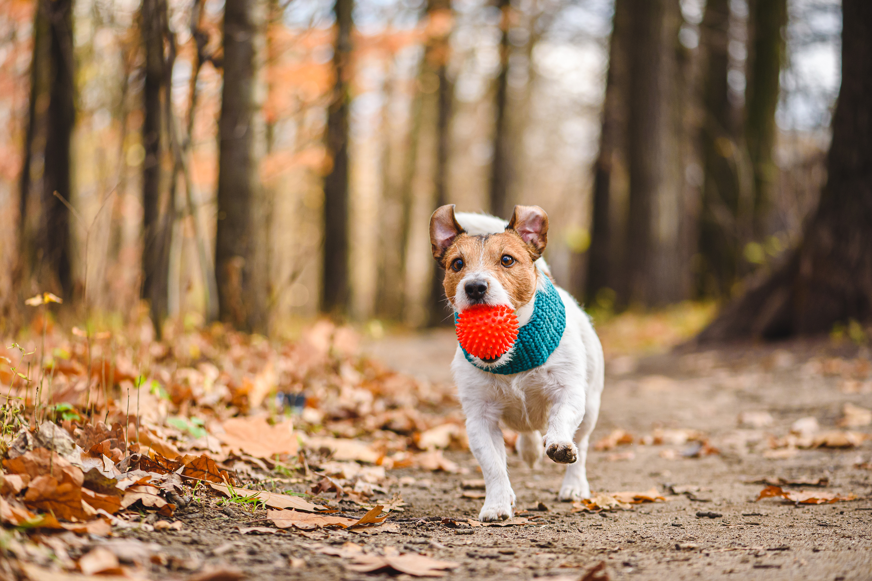
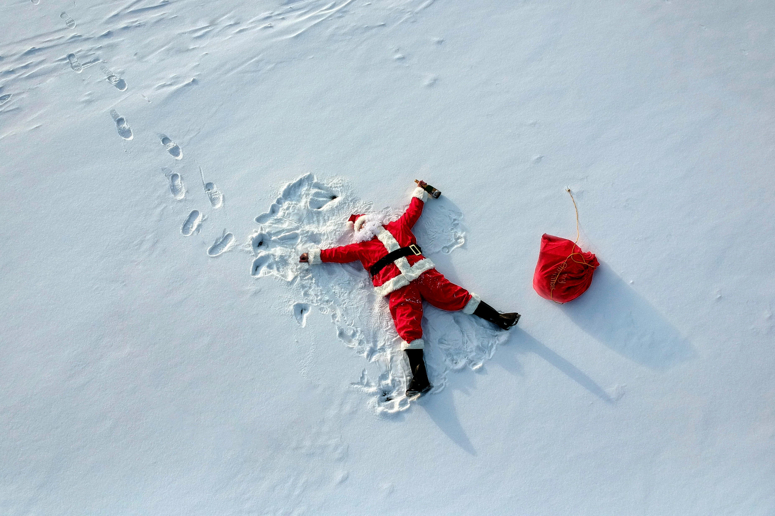
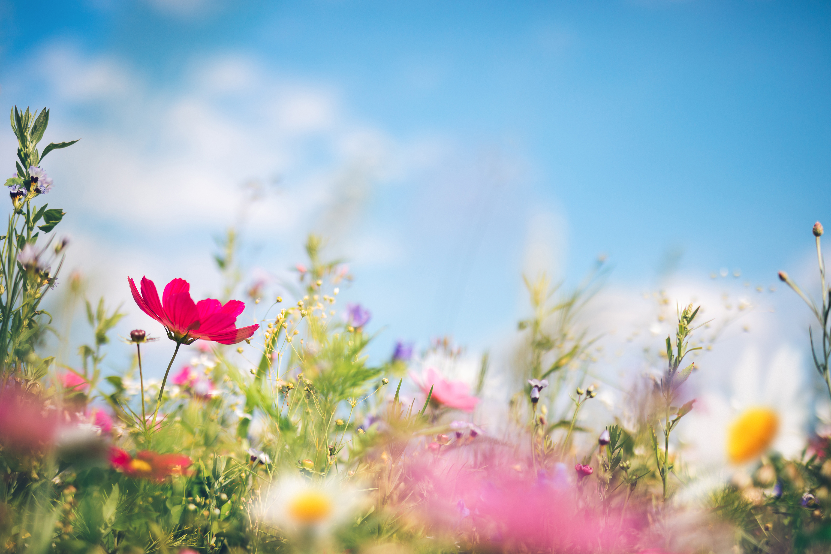
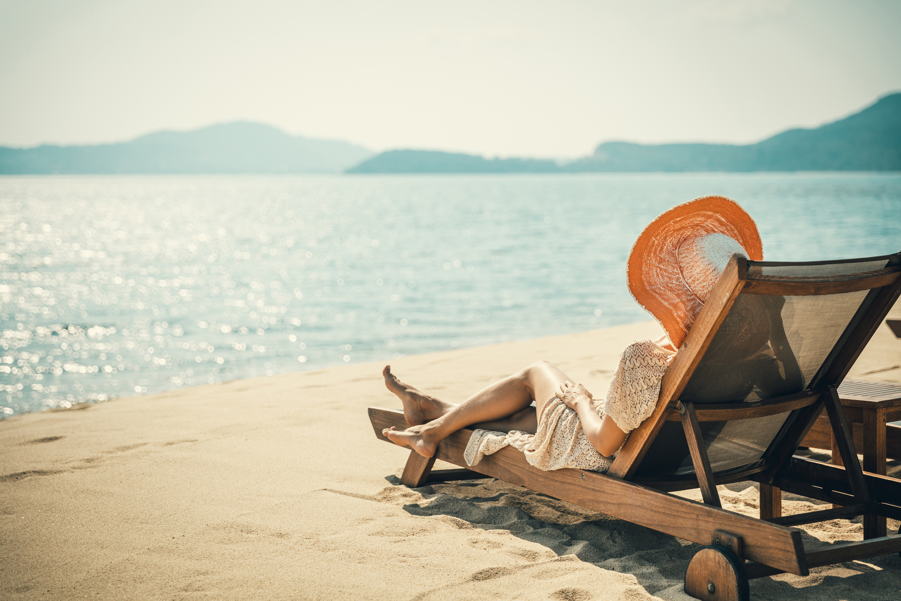

SEASONS
SEN Power Project 2022-1-BG01-KA220-SCH-00085065

Slide 3
SEN Power Project 2022-1-BG01-KA220-SCH-00085065

Slide 4
SEN Power Project 2022-1-BG01-KA220-SCH-00085065

Slide 5
SEN Power Project 2022-1-BG01-KA220-SCH-00085065

Slide 6
SEN Power Project 2022-1-BG01-KA220-SCH-00085065

Slide 7
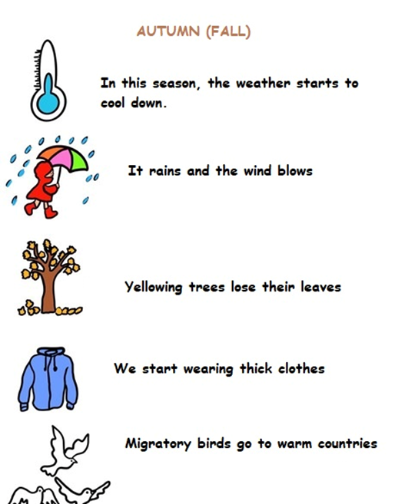
Grade 1: Understands The Changes That Occur in The Nature According to The Seasons Annex 3

Slide 8
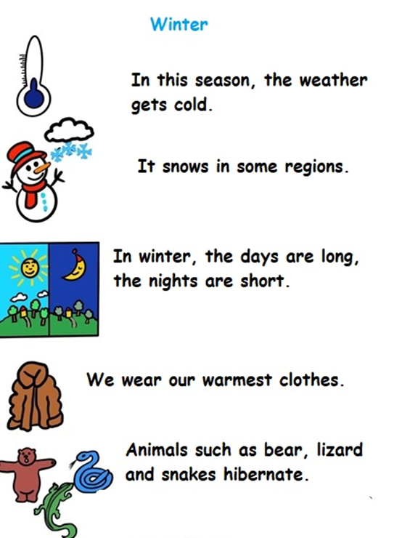
Grade 1: Understands The Changes That Occur in The Nature According to The Seasons Annex 3

Slide 9
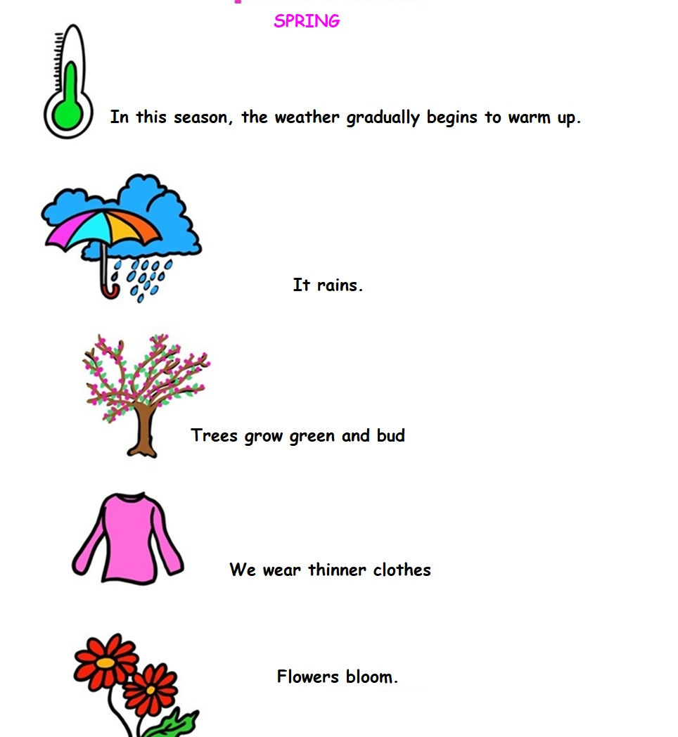
Grade 1: Understands The Changes That Occur in The Nature According to The Seasons Annex 3

Slide 10
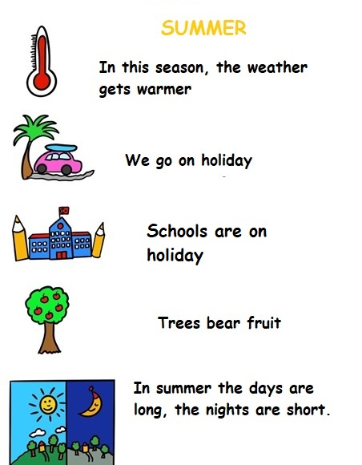
Grade 1: Understands The Changes That Occur in The Nature According to The Seasons Annex 3

Slide 11






2022-1-BG01-KA220-SCH-000085065
School subject: Natural Science
Students’Age: 7 years
Topic: Seasons
Credits: Antalya Directorate Of Education
All media are within the EU intellectual property law.
The European Commission’s support for this publication does not constitute an endorsement of the contents, which reflect the views only of the authors, and the Commission cannot be held responsible for any use which may be made of the information contained herein.

